Slide 1
Design Principles
Another way of conceptualizing usability is in terms of design principles.
These are generalizable abstractions intended to orient designers towards thinking about different aspects of their designs.
More specifically, they are intended to help designers explain and improve the design.
However, they are not intended to specify how to design an actual interface
(e.g., telling the designer how to design a particular icon or how to structure a web portal)
The best known design principles concerned with how to determine what users should see and do when carrying out their tasks using an interactive product.

Slide 2
Design Principles by Don Norman
Visibility
Feedback
Constraints
Mapping
Consistency
Affordance

Slide 3
Design Principles by Don Norman (Contd.)
Visibility:
The more visible functions are, the more likely users will be able to know what to do next. In contrast, when functions are "out of sight," it makes them more difficult to find and know how to use.
Feedback:
Related to the concept of visibility is feedback.
Feedback is about sending back information about what action has been done and what has been accomplished, allowing the person to continue with the activity. Various kinds of feedback are available for interaction design:
audio, tactile, verbal, visual, and combinations of these. Deciding which combinations are appropriate for different kinds of activities and interactivities is central.
Using feedback in the right way can also provide the necessary visibility for user interaction.

Slide 4
Design Principles by Don Norman (Contd.)
Constraints:
The design concept of constraining refers to determining ways of restricting the kind of user interaction that can take place at a given moment.
A common design practice in graphical user interfaces is to deactivate certain menu options by shading them, thereby restricting the user to only actions permissible at that stage of the activity.
One of the advantages of this form of constraining is it prevents the user from selecting incorrect options and thereby reduces the chance of making a mistake.

Slide 5
Design Principles by Don Norman (Contd.)
Constraints (Contd.):
Norman (1999) classifies constraints into three categories:
Physical: refer to the way physical objects restrict the movement of things.
For example, the way an external disk can be placed into a disk drive is physically constrained by its shape and size, so that it can be inserted in only one way.
Logical: rely on people's understanding of the way the world works. They rely on people's common-sense reasoning about actions and their consequences. Making actions and their effects obvious enables people to logically deduce what further actions are required.
Disabling menu options when not appropriate for the task in hand provides logical constraining. It allows users to reason why (or why not) they have been designed this way and what options are available.

Slide 6
Design Principles by Don Norman (Contd.)
Constraints (Contd.):
Cultural: Cultural constraints rely on learned conventions. They have to be learned. Once learned and accepted by a cultural group, they become universally accepted conventions.
Two universally accepted interface conventions are the use of windowing for displaying information and the use of icons on the desktop to represent operations and documents.
like the use of red for warning, the use of certain kinds of audio signals for danger, and the use of the smiley face to represent happy emotions.

Slide 7
Design Principles by Don Norman (Contd.)
Mapping:
This refers to the relationship between controls and their effects in the world.
Nearly all artifacts need some kind of mapping between controls and effects, whether it is a flashlight, car, power plant, or cockpit.
An example of a good mapping between control and effect is the up and down arrows used to represent the up and down movement of the cursor, respectively, on a computer keyboard.
Mapping of the relative position of controls and their effects is also important.

Slide 8
Design Principles by Don Norman (Contd.)
Consistency:
This refers to designing interfaces to have similar operations and use similar elements for achieving similar tasks. In particular, a consistent interface is one that follows rules, such as using the same operation to select all objects.
For example, a consistent operation is using the same input action to highlight any graphical object at the interface, such as always clicking the left mouse button.
One of the benefits of consistent interfaces, therefore, is that they are easier to learn and use.

Slide 9
Design Principles by Don Norman (Contd.)
Affordance:
Refer to an attribute of an object that allows people to know how to use it.
At a very simple level, to afford means "to give a clue"
There are two kinds of affordance:
Perceived: user interfaces that are screen-based are virtual and do not have these kinds of real affordances.
Real: Physical objects are said to have real affordances, like grasping, that are perceptually obvious and do not have to be learned.

Slide 10
Design Principles by Don Norman (Contd.)
Affordance (Contd.):
It does not make sense to try to design for real affordances at the interface except when designing physical devices, like control consoles, where affordances like pulling and pressing are helpful in guiding the user to know what to do.
Alternatively, screen-based interfaces are better conceptualized as perceived affordances, which are essentially learned conventions.
In conclusion, Norman argues that other design concepts: conventions, feedback and cultural and logical constraints-are far more useful for helping designers develop graphical user interfaces.

Slide 11
Heuristics and usability principles
When design principles are used in practice they are commonly referred to as heuristics.
This term emphasizes that something has to be done with them when they are applied to a given problem.
Another form of guidance is usability principles. These are quite similar to design principles, except that they tend to be more prescriptive.
In addition, whereas design principles tend to be used mainly for informing a design, usability principles are used mostly as the basis for evaluating prototypes and existing systems.
In particular, they provide the framework for heuristic evaluation.
They, too, are called heuristics when used as part of evaluation.

Slide 12
Heuristics and usability principles - usability principles developed by Nielsen (2001)
Visibility of system status: always keep users informed about what is going on, through providing appropriate feedback within reasonable time
Match between system and the real world: speak the users' language, using words, phrases and concepts familiar to the user, rather than system oriented terms
User control and freedom: provide ways of allowing users to easily escape from places they unexpectedly find themselves, by using clearly marked 'emergency exits'
Consistency and standards: avoid making users wonder whether different words, situations, or actions mean the same thing
Help users recognize, diagnose, and recover from errors: use plain language to describe the nature of the problem and suggest a way of solving it

Slide 13
Heuristics and usability principles - usability principles developed by Nielsen (Contd.)
Error prevention: where possible prevent errors occurring in the first place
Recognition rather than recall: make objects, actions, and options visible
Flexibility and efficiency of use: provide accelerators that are invisible to novice users, but allow more experienced users to carry out tasks more quickly
Aesthetic and minimalist design: avoid using information that is irrelevant or rarely needed
Help and documentation: provide information that can be easily searched and provides help in a set of concrete steps that can easily be followed

Slide 14
Shneiderman’s Eight Golden Rules of Interface Design
Strive for consistency in action sequences, layout, terminology, command use and so on.
Enable frequent users to use shortcuts, such as abbreviations, special key sequences and macros, to perform regular, familiar actions more quickly.
Offer informative feedback for every user action, at a level appropriate to the magnitude of the action.
Design dialogs to yield closure so that the user knows when they have completed a task.

Slide 15
Shneiderman’s Eight Golden Rules of Interface Design
Offer error prevention and simple error handling so that, ideally, users are prevented from making mistakes and, if they do, they are offered clear and informative instructions to enable them to recover.
Permit easy reversal of actions in order to relieve anxiety and encourage exploration, since the user knows that he can always return to the previous state.
Support internal locus of control so that the user is in control of the system, which responds to his actions.
Reduce short-term memory load by keeping displays simple, consolidating multiple page displays and providing time for learning action sequences.

Slide 16
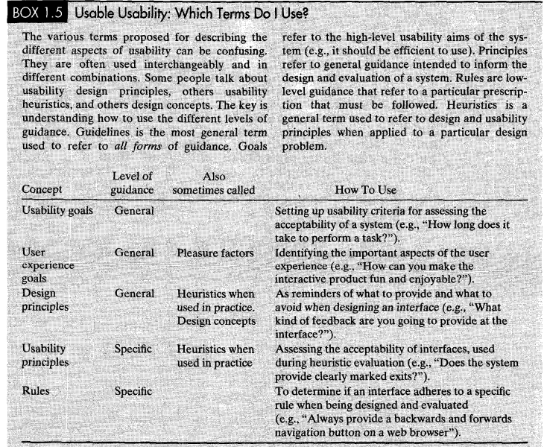

Slide 17
